Slide 1


Data Structure
Course Code : ENCS205
Dr Swati Gupta
Associate Professor, School of Engineering & Technology
K.R. Mangalam University
Unit 3 :Trees and Graphs
Notes:
New Courses replaced with New Programmes

Slide 2

THREADED TREES
Session 51
Introduction to Threaded Trees
Properties of Threaded Trees
Types of Threaded Trees
Operations on Threaded Trees
Brainstorming Session
Notes:
New Courses replaced with New Programmes

Slide 3
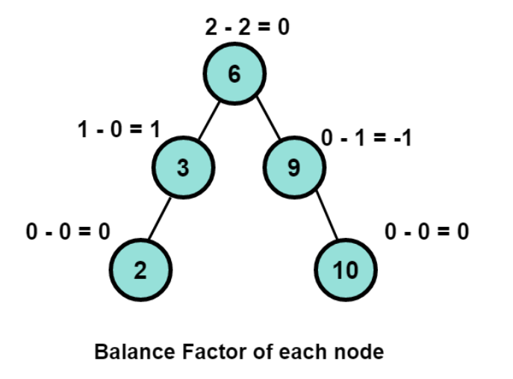
RECAP
An AVL tree is an height balanced binary search tree in which each node is associated with a balance factor
The balanced factor should be -1, 0 or +1. Otherwise, the tree will be considered an unbalanced tree.
Notes:
New Courses replaced with New Programmes

Slide 4
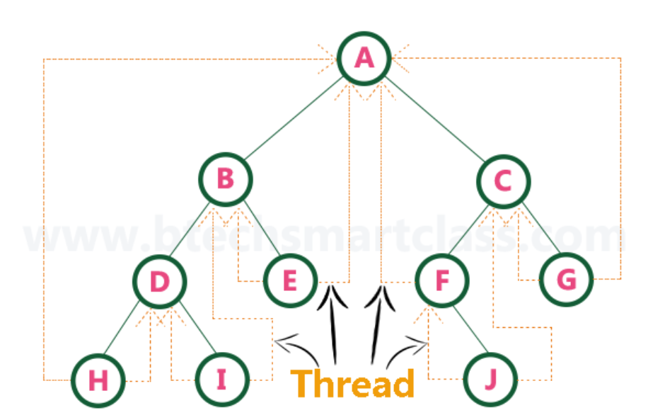
Basic Introduction
Many nodes present in this tree hold a NULL value in their left or right child pointer.
One possible way to utilise this space is to have a special pointer that points to nodes higher in the tree (i.e. ancestors) known as threads.
Notes:
New Courses replaced with New Programmes

Slide 5
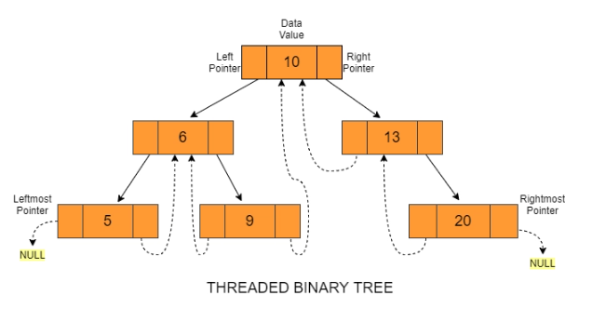
Threaded Binary Trees
A threaded binary tree is a type of binary trees in which all left child pointers that are NULL (in Linked list representation) points to its in-order predecessor, and all right child pointers that are NULL (in Linked list representation) points to its in-order successor.
Notes:
New Courses replaced with New Programmes

Slide 6
Need for a Threaded Binary Tree
The need for threaded Binary trees are as follows :
Space Optimization
Time Efficiency
Simplification of Tree Operations
Non-recursive Traversals
Notes:
New Courses replaced with New Programmes

Slide 7
Types of Threaded Binary Trees
There are two types of threaded binary trees
Single Threaded: Where a NULL right pointers is made to point to the inorder successor (if successor exists)
Double Threaded: Where both left and right NULL pointers are made to point to inorder predecessor and inorder successor respectively.
Notes:
New Courses replaced with New Programmes

Slide 8
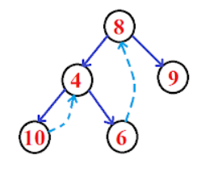
Single Threaded Binary Trees
A thread will appear either in the right or left link field of a node.
If it appears in the right link field of a node then it will point to the next node that will appear on performing in order traversal. Such trees are called Right Single threaded binary trees.
Notes:
New Courses replaced with New Programmes

Slide 9
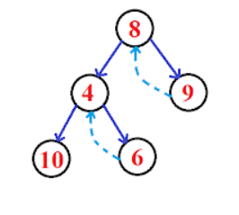
Single Threaded Binary Trees
If it appears in the left link field of a node then it will point to the next node that will appear on performing in order traversal. Such trees are called Left Single threaded binary trees.
Notes:
New Courses replaced with New Programmes

Slide 10
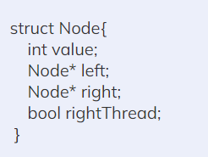
Node Structure of Single Threaded Binary Trees
In threaded binary trees, we need to use extra boolean variables in the node structure.
Notes:
New Courses replaced with New Programmes

Slide 11
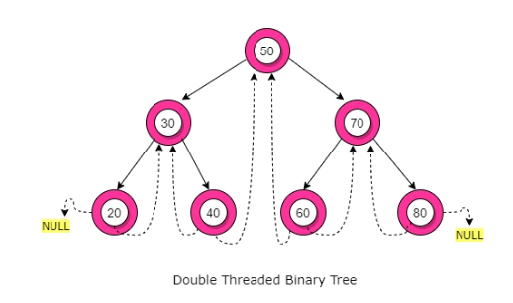
Double Threaded Binary Trees
In this type, the left null pointer of a node is made to point towards the in-order predecessor node and the right null pointer is made to point towards the in-order successor node.
Notes:
New Courses replaced with New Programmes

Slide 12
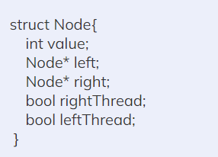
Node Structure of Double-Threaded Binary Trees
In this type, the left null pointer of a node is made to point towards the in-order predecessor node and the right null pointer is made to point towards the in-order successor node.
Notes:
New Courses replaced with New Programmes

Slide 13

Operations on Threaded Tree
Insertion Operation

Slide 14
Insertion in Threaded tree
1. Initialize: Set current to the leftmost node of the tree using the Leftmost(root) function
2. Traversal Loop: While current is not null, repeat the following steps
3. Process Node: Process the current node by performing the desired action using the ProcessNode function
Notes:
New Courses replaced with New Programmes

Slide 15
Insertion in Threaded tree
4. Move to In-Order Successor:
If the current node has a right thread: Set current to the node's right thread
Else: Set current to the leftmost node in the right subtree using Leftmost(current.rightChild)
5. Repeat: Go back to step 2 until all nodes are visited
6. Finish: The algorithm completes when all nodes in the threaded binary tree are processed
Notes:
New Courses replaced with New Programmes

Slide 16
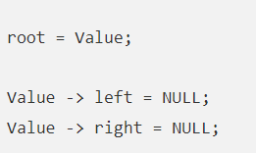
Insertion in Threaded tree
Case 1: When a new node is inserted in an empty tree
The new node value becomes the root node, and both the left and right pointers of the value will be set to NULL.
Notes:
New Courses replaced with New Programmes

Slide 17

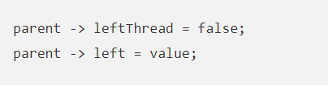
Insertion in Threaded tree
Case 2: When a new node is inserted as a left child
After inserting the node at its proper place, we will make its left and right child pointers point to in-order predecessor and successor, respectively. So the left and right threads of the new node will be:
Before insertion, the left pointer of the parent was a thread, but after insertion, it will be a link pointing to the new node.
Notes:
New Courses replaced with New Programmes

Slide 18

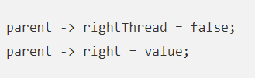
Insertion in Threaded tree
Case 3: When a new node is inserted as a right child
The node that was the parent’s in-order successor is now the in-order successor of this new node value. So the left and right threads of the new node will be:
Before insertion, the right pointer of the parent was a thread, but after insertion, it will be a link pointing to the new node.
Notes:
New Courses replaced with New Programmes

Slide 19
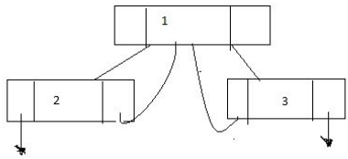
Test Your Knowledge
Q1 In general, the node content in a threaded binary tree is ________
a) leftchild_pointer, left_tag, data, right_tag, rightchild_pointer b) leftchild_pointer, left_tag c) leftchild_pointer, left_tag, right_tag, rightchild_pointer d) leftchild_pointer, left_tag, data
Answer (A)
Q2 What is inefficient with the below threaded binary tree picture?
it has dangling pointers
nothing inefficient
incorrect threaded tree
space is being used more
Answer (A)
Notes:
New Courses replaced with New Programmes

Slide 20
Test Your Knowledge
Q3 Which of the following is true
The AVL trees are more balanced compared to Red Black Trees, but they may cause more rotations during insertion and deletion.
Heights of AVL and Red-Black trees are generally same, but AVL Trees may cause more rotations during insertion and deletion.
Red black trees are more balanced compared to AVL trees but may cause more rotations during insertion and deletion.
Heights of AVL and Red-Black trees are generally same, but Red Black trees may cause more rotations during insertion and deletion.
Answer (A)
Q4 Which of the following is TRUE?
The cost of searching an AVL tree is θ (log n) but that of a binary search tree is O(n)
The cost of searching an AVL tree is θ (log n) but that of a complete binary tree is θ (n log n)
The cost of searching a binary search tree is O (log n ) but that of an AVL tree is θ(n)
The cost of searching an AVL tree is θ (n log n) but that of a binary search tree is O(n)
Answer (A)
Notes:
New Courses replaced with New Programmes

Slide 21
REVIEW
A threaded binary tree is a type of binary trees in which:
All left child pointers that are NULL (in Linked list representation) points to its in-order predecessor,
All right child pointers that are NULL (in Linked list representation) points to its in-order successor.
Notes:
New Courses replaced with New Programmes

Slide 22
References
https://www.youtube.com/watch?v=oSWTXtMglKE
https://www.upgrad.com/blog/5-types-of-binary-tree/
https://www.javatpoint.com/tree
https://www.geeksforgeeks.org/tree-data-structure/
https://www.sanfoundry.com/1000-data-structure-questions-answers/
https://www.tutorialspoint.com/data_structures_algorithms/array_data_structure.htm
https://www.tutorialspoint.com/data_structures_algorithms/tree_data_structure.htm
https://www.simplilearn.com/tutorials/data-structure-tutorial/trees-in-data-structure
https://www.scaler.com/topics/data-structures/tree-data-structure/
Notes:
New Courses replaced with New Programmes

Slide 23
THANK YOU

